Slide 1
MODERN STYLE
PREMIUM DESIGN
INDUSTRIAL ENGINEERING
THESIS DEFENSE
01
02
03
04
05
06
Presenter: [Your Name]
Date: [Presentation Date]
BEST COMPANY

Slide 2
Table of Contents
Introduction
Case Study Analysis
  Overview of the Thesis
  Objectives of the Research
  Review of Existing Literature in Industrial Engineering
  Key Findings and Trends in Process Optimization and Sustainability
Literature Review
Research Methodology
  Case Study 1: Analysis of Manufacturing
  Case Study 2: Optimization of Logistics
  Research Design and Approach
  Data Collection Methods

Slide 3

Introduction
Introduction to the Thesis: Welcome to the defense of my thesis on optimizing industrial processes. This research focuses on improving efficiency and sustainability within industrial settings, addressing key challenges and proposing innovative solutions.
Objectives: The primary objectives of this study are to analyze current industrial processes, identify areas for optimization, and propose strategies to enhance efficiency and sustainability.
Importance: Industrial engineering plays a crucial role in streamlining operations, reducing waste, and minimizing environmental impact.

Slide 4




Welcome To Presentation
I'm Rain, and I'll be sharing with you my beautiful ideas. Follow me at @reallygreatsite to learn more.

Slide 5


Literature Review
Overview of Industrial Engineering Literature
This section provides a comprehensive review of existing literature in the field of industrial engineering, focusing on topics such as process optimization, lean manufacturing, sustainability, and performance measurement.
Key Findings
The literature review highlights current trends, challenges, and best practices in industrial process optimization, serving as a foundation for the research conducted in this thesis.

Slide 6




Research Methodology
Research Design
Data Analysis
The methodology section outlines the research approach adopted for this study, including data collection methods, analysis techniques, and evaluation criteria.
Quantitative and qualitative data analysis techniques were employed to identify patterns, trends, and opportunities for improvement within the selected industrial processes.
Slide 5-10: Case Study Analysis
Case Studies
A series of case studies were conducted to assess industrial processes in various sectors, including manufacturing, logistics, and supply chain management.

Slide 7


Study Analysis
Case Study 1: Analysis of Manufacturing Processes
Case Study 2: Optimization of Logistics Operations
Case Study 3: Sustainable Supply Chain Management
Each case study provides an in-depth analysis of the industrial process
under investigation, highlighting key findings, challenges, and proposed optimization strategies.

Slide 8

Analysis
Each case study provides an in-depth analysis of the industrial process under investigation, highlighting key findings, challenges, and proposed optimization strategies.

Slide 9

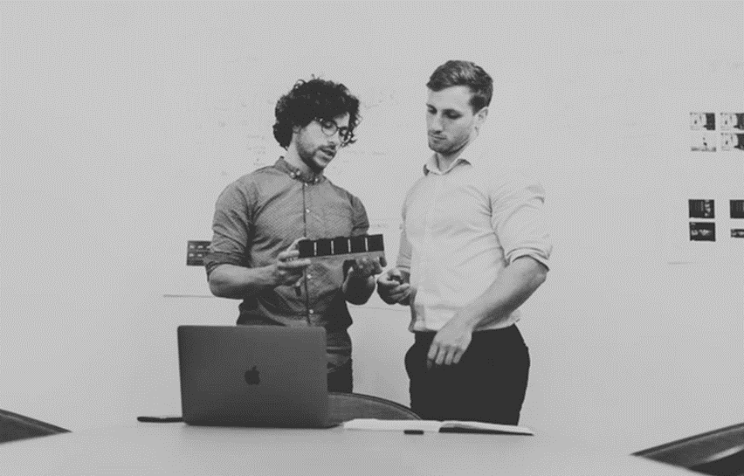




PROJECT IMAGE

Slide 10


Optimization Strategies
Process Redesign
Lean Principles
The thesis proposes process redesign initiatives aimed at streamlining operations, reducing cycle times, and improving resource utilization.
Implementation of lean manufacturing principles to eliminate waste, minimize downtime, and enhance productivity.

Slide 11

Sustainability Initiatives
Environmental Impact Assessment: An assessment of the environmental impact of industrial processes, with a focus on reducing carbon emissions, energy consumption, and waste generation.
Renewable Energy Integration: Exploration of renewable energy sources and their potential integration into industrial operations to promote sustainability and reduce reliance on fossil fuels.
Circular Economy Principles: Adoption of circular economy principles to minimize resource depletion, promote recycling and reuse, and create a more sustainable industrial ecosystem.

Slide 12

A picture is worth a thousand words

Slide 13

Results and Findings
Summary of Results
This section provides a summary of the findings from the case studies and analysis conducted throughout the research.
Key Insights
Insights gained from the research highlight the effectiveness of optimization strategies in improving efficiency, reducing costs, and enhancing sustainability within industrial processes.

Slide 14


Discussion
Implications: Discussion on the implications of the research findings for industrial engineering practice, highlighting the potential benefits of implementing optimization strategies.
Limitations: Identification of limitations and challenges encountered during the research process, along with recommendations for future studies.

Slide 15

Conclusion
Concluding Remarks
Closing remarks expressing gratitude to the thesis committee, academic advisors, and colleagues for their support throughout the research process.
Summary
A concise summary of the research objectives, methodology, findings, and implications.

Slide 16



Recommendations
Recommendations for Future Research: Suggestions for future research directions, including areas for further exploration and refinement of optimization strategies.

Slide 17
Write an original statement or inspiring quote
— Include a credit, citation, or supporting message

Slide 18

BEST THANKS!
[Your Company Name]
[Contact Information]
[Logo]

Slide 19







Resource Page
Use these design resources in your Canva Presentation.
You can find these fonts online too. Happy designing!
Don't forget to delete this page before presenting.
This presentation template uses the following free fonts:
  Titles: BEBAS NEUE
  Headers: BEBAS NEUE
  Body Copy: Arimo

Slide 20

Credits
This presentation template is free for everyone to use thanks to the following:
SlidesCarnival for the presentation template
Pexels for the photos
Happy designing!

